Slide 1
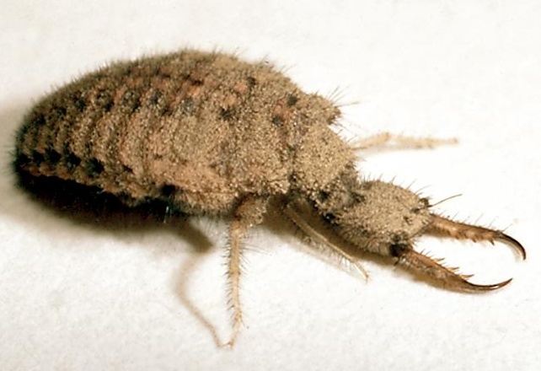
003 Antlion Larvae
Neuroptera
Holometabolous
Chewing outhpart
Beneficial

Slide 2
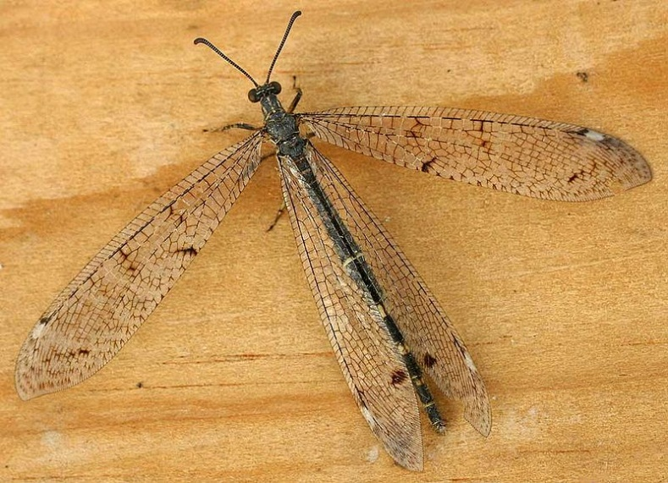
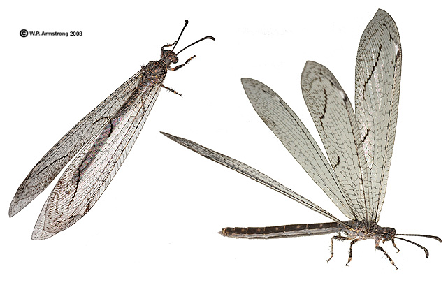
002 Antlion
Neuroptera
Holometabolous
Chewing outhpart
Beneficial

Slide 3
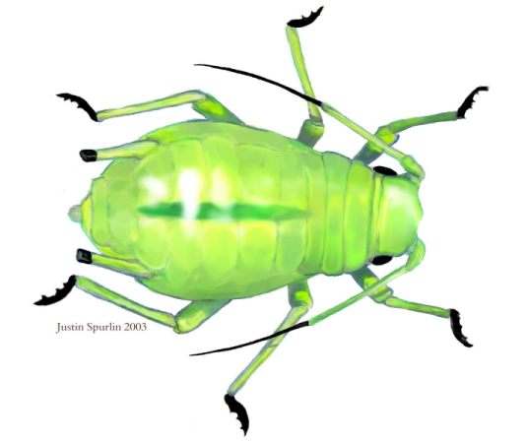
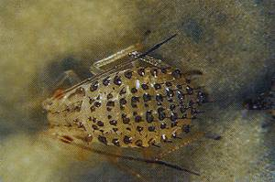
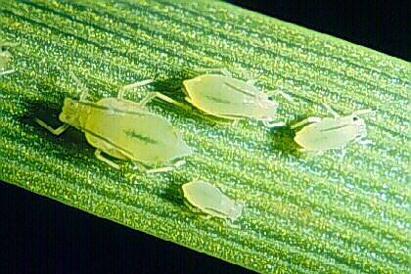
004 Aphid
Hemiptera
Hemimetabolous
Piercing-sucking
Pest

Slide 4
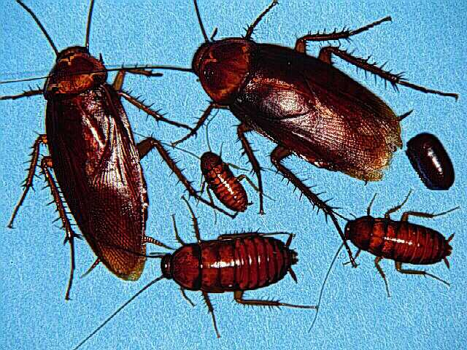
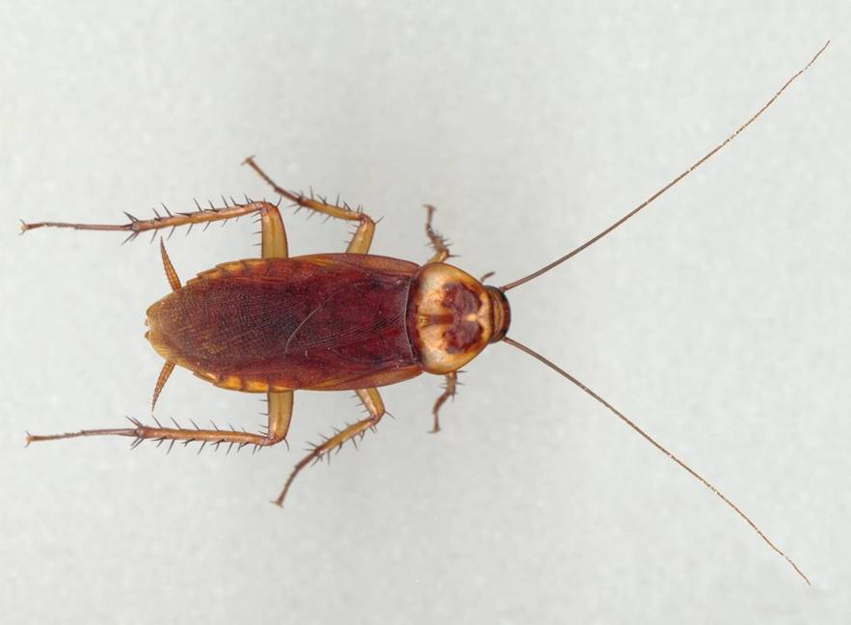
001 American cockroach
Order Blattodea
Hemi-metabolous
Chewing Mouthpart
Pest

Slide 5
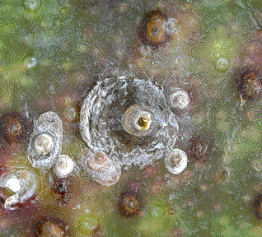
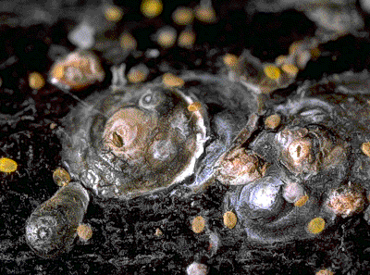
005 Armored scale
Hemiptera
Hemimetabolous
Piercing-sucking
Pest

Slide 6
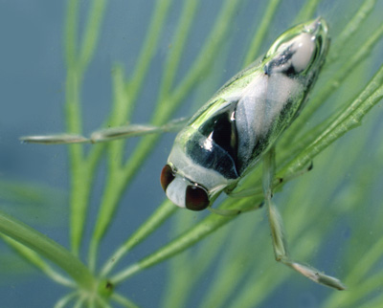
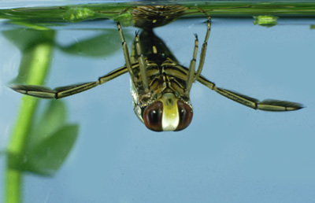
007 Backswimmer
Hemiptera
Hemimetabolous
Piercing-sucking
Beneficial

Slide 7
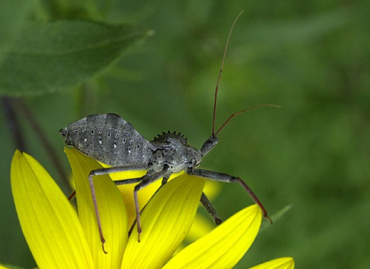
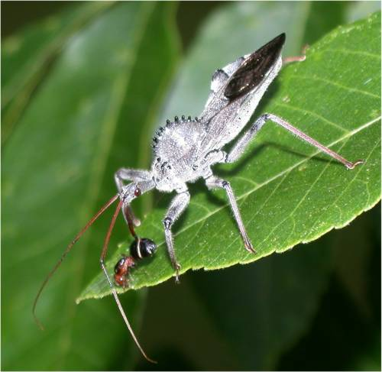
006 Assassin Bug
Hemiptera
Hemimetabolous
Piercing-sucking
Beneficial

Slide 8
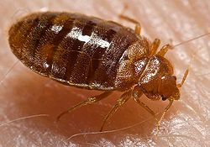
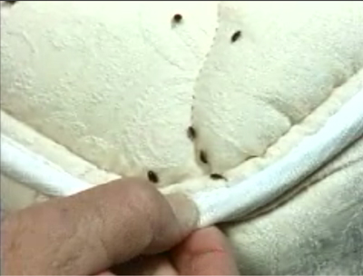
009 Bed bug
Hemiptera
Hemimetabolous
Piercing-sucking
Pest

Slide 9
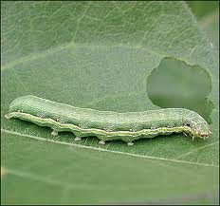
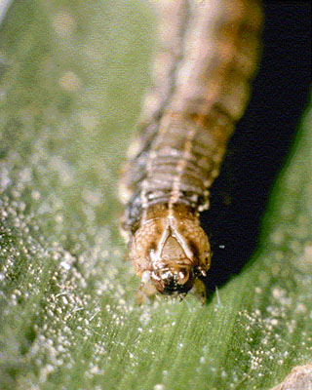
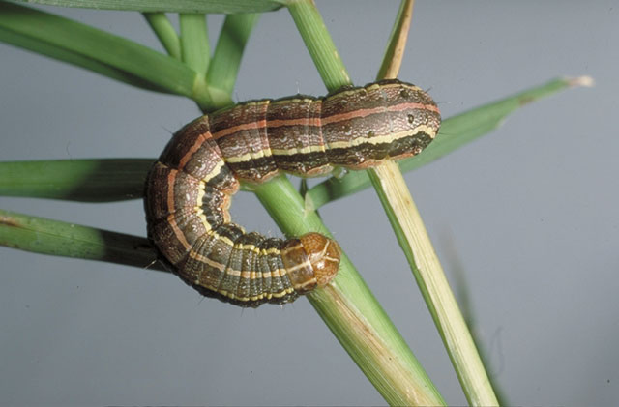
010 Beet armyworm larva
Lepidoptera
Holometabolous
Chewing
Pest

Slide 10
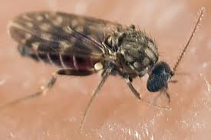
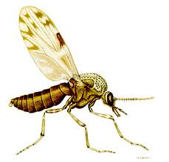
013 Biting midge
Diptera
Holometablous
Piercing-sucking
Pest

Slide 11
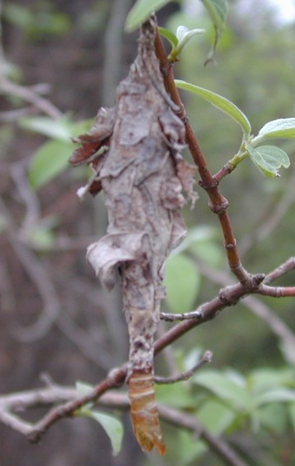
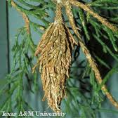
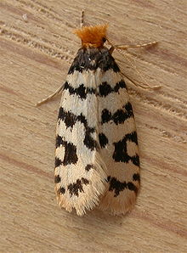
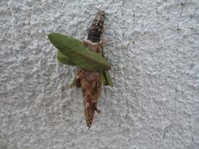
008 Bagworm
Lepidoptera
Holometabolous
Chewing
Pest

Slide 12
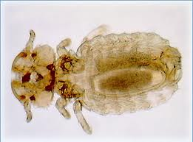
012 Biting louse
Phthiraptera
Hemimetabolous
Chewing
Pest

Slide 13
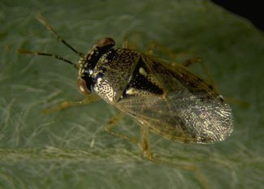
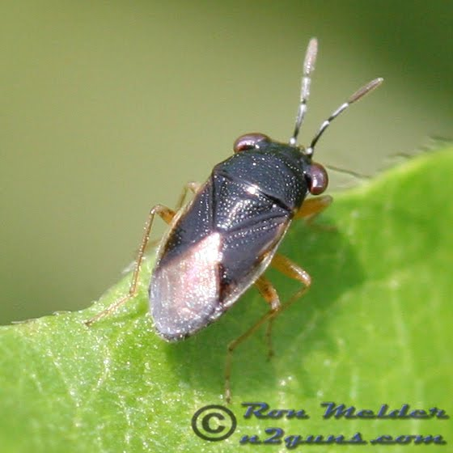
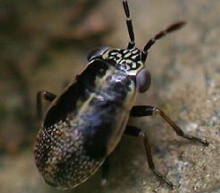
011 Big-eyed bug
Hemiptera
Hemimetabolous
Piercing-sucking
Beneficial

Slide 14
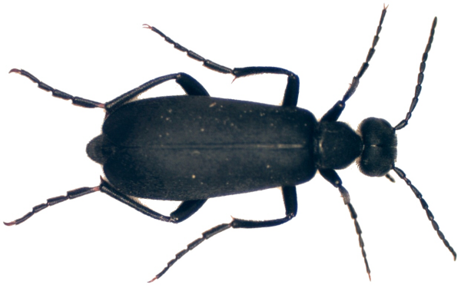
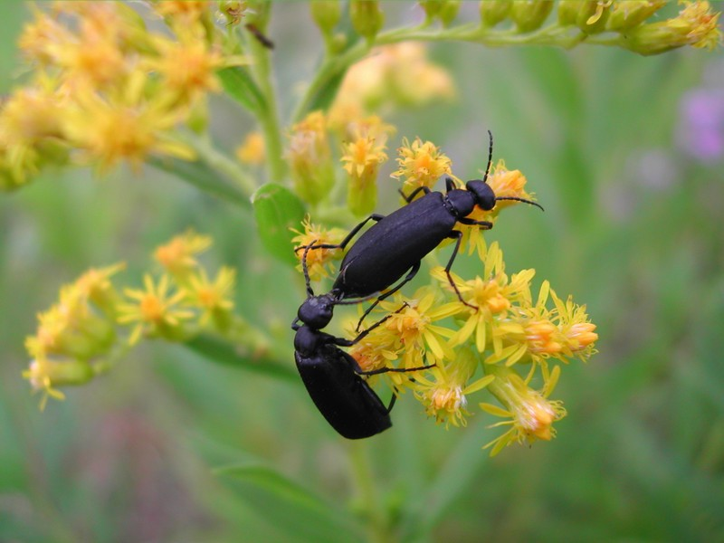
015 Blister beetle
Coleoptera
holometabolous
Chewing
Pest

Slide 15
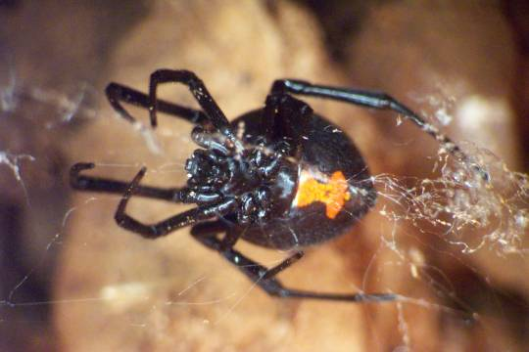
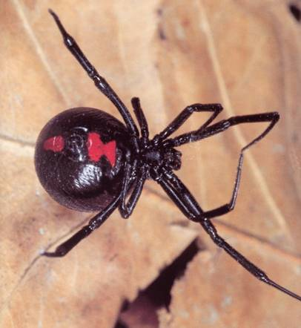
014 Black widow spider
Non-insect
Pest

Slide 16
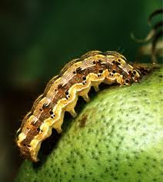
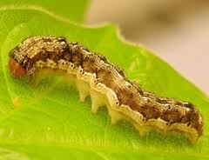
018 Bollworm
Lepidoptera
Holo-metabolous
Chewing
Pest

Slide 17
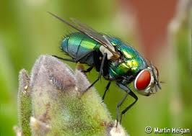
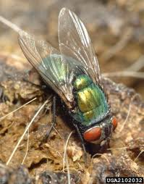
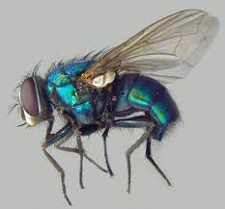
016 Blow fly
Diptera
Holometabolous
Sponging
Pest

Slide 18
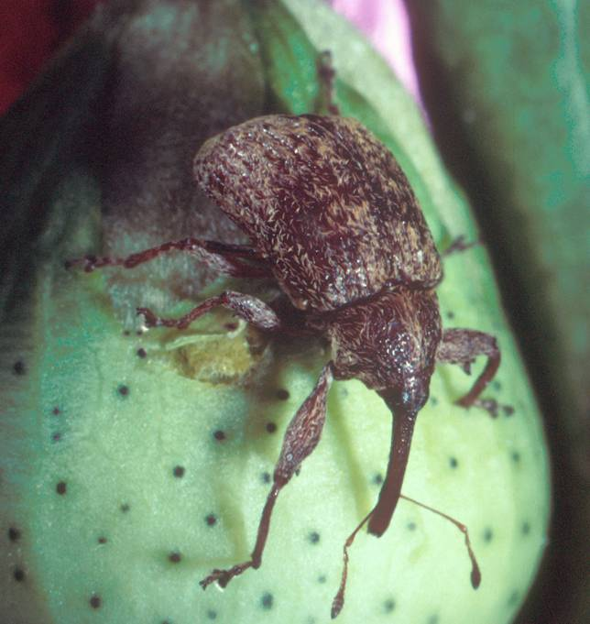
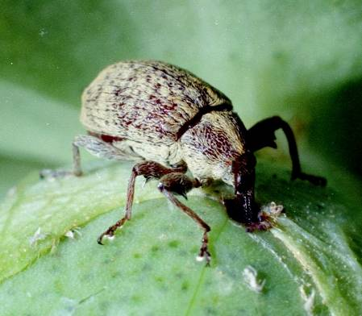
017 Boll weevil
Coleoptera
Holometabolous
Chewing
Pest

Slide 19
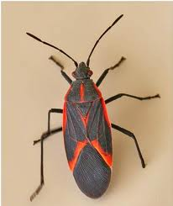
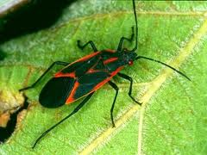
019 Boxelder bug
Hemiptera
Hemimetabolous
Piercing-sucking
Pest

Slide 20
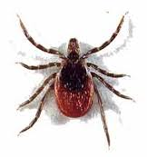
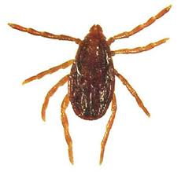
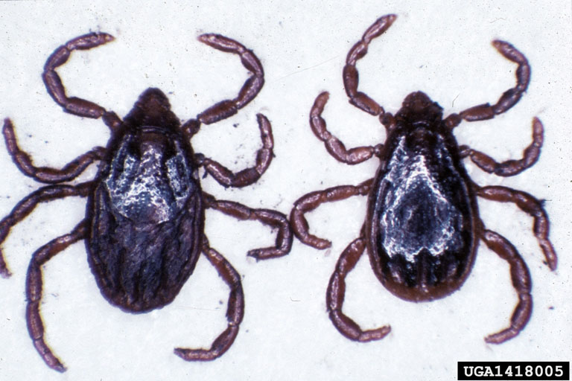
021 Brown dog tick
Non-insect
Piercing-sucking
Pest

Slide 21
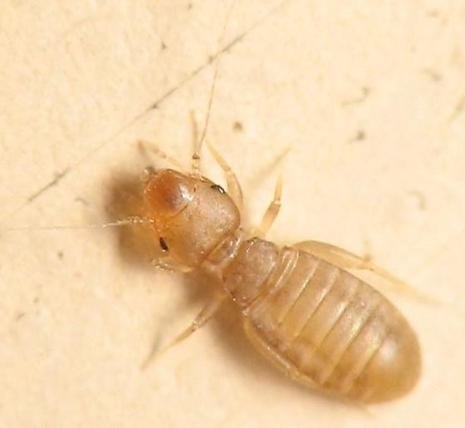
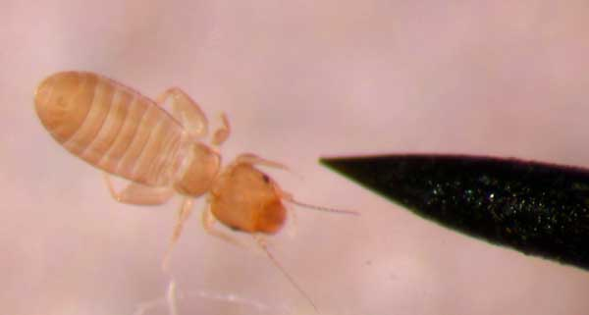
020 Book louse
Psocoptera
Ametabolus
Chewing
Pest

Slide 22
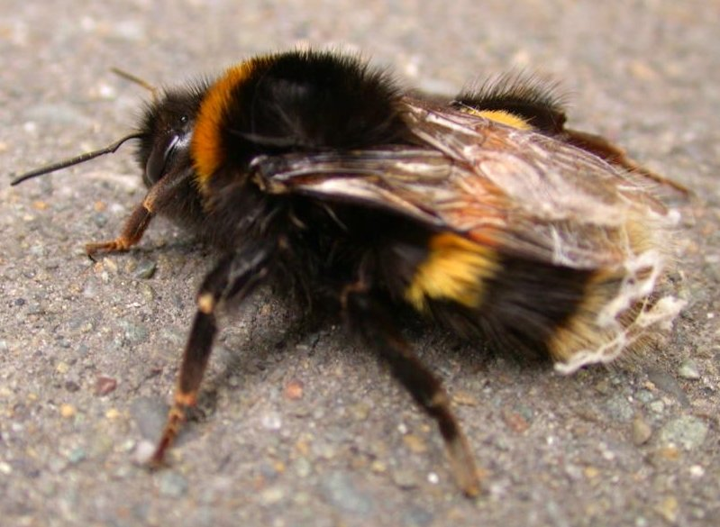
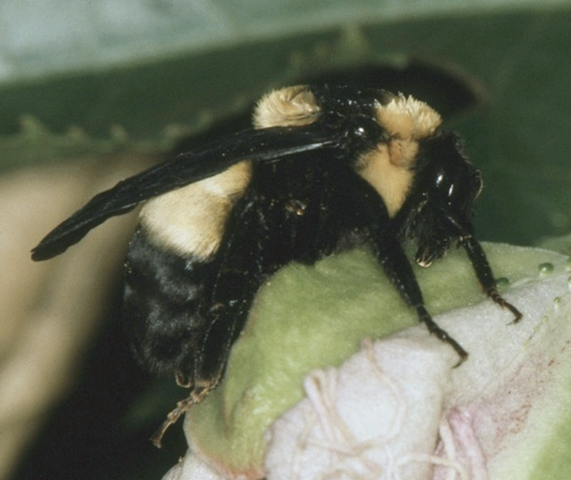
023 Bumble bee
Hymenoptera
Holometabolous
Chewing-lapping
Variable (Pest and Beneficial)

Slide 23
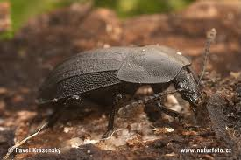
026 Carrion beetle
Coleoptera
Holometabolous
Chewing
Beneficial

Slide 24
022 Brown recluse spider
Non-insect
Pest

Slide 25
024 Cabbage looper
Lepidoptera
Holometabolous
Chewing
Pest

Slide 26
025 Carpet beetle
Coleoptera
Holometabolous
Chewing
Pest

Slide 27
027 Cattle grub
Diptera
Holometabolous
Chewing
Pest

Slide 28
031 Cigarette beetle
Coleoptera
Holometabolous
Chewing
Pest

Slide 29
029 Cicada
Hemiptera
Hemimetabolous
Piercing-sucking
Variable

Slide 30
028 Centipede
Non-insect
Variable

Slide 31
030 Cicada Killer
Hymenoptera
Colometabolous
Chewing
Beneficial

Slide 32
032 Click beetle
Coleoptera
Holometabolous
Chewing
Variable (Beneficial and Pest)

Slide 33
034 Crab spider
Non-insect
Beneficial

Slide 34
033 Colorado potato beetle
Coleoptera
Holometabolous
Chewing
Pest

Slide 35
035 Crane fly
Diptera
Holometabolous
Piercing-sucking
Variable (Beneficial and Pest)

Slide 36
037 Damselfly
Odonata
Hemimetabolous
Chewing
Beneficial

Slide 37
036 Damsel bug
Hemiptera
Hemimetabolous
Piercing-sucking
Beneficial

Slide 38
038 Damselfly nymph
Odonata
Hemimetabolous
Chewing
Beneficial

Slide 39
041 Deer ked
Diptera
Holometabolous
Piercing-sucking
Pest

Slide 40
039 Darkling beetle
Coleoptera
Holometabolous
Chewing
Variable (Beneficial and Pest)

Slide 41
040 Deer fly
Diptera
Holometabolous
Cutting-sponging
Pest

Slide 42
041 Dobsonfly
Neuroptera
Holometabolous
Chewing
Beneficial

Slide 43
043 Dragonfly
Odonata
Hemimetabolous
Chewing
Beneficial

Slide 44
044 Dragonfly nymph
Odonata
Hemimetabolous
Chewing
Beneficial

Slide 45
045 Dung beetle
Coleoptera
Holometabolous
Chewing
Beneficial

Slide 46
046 Earwig
Dermaptera
Hemimetabolous
Chewing
Beneficial

Slide 47
047 Elm leaf beetle
Coleoptera
Holometabolous
Chewing
Pest

Slide 48
048 Fall webworm
Lepidoptera
Holometabolous
Chewing
Pest

Slide 49
049 Field cricket
Orthoptera
Hemimetabolous
Chewing
Pest

Slide 50
050 Firefly
Coleoptera
Holometabolous
Chewing
Beneficial

Slide 51
051 Flea
Siphonaptera
Holometabolous
Piercing-sucking
Pest

Slide 52
052 Flea beetle
Coleoptera
Holometabolous
Chewing
Pest

Slide 53
053 Flesh fly
Diptera
Holometabolous
Sponging
Pest

Slide 54
054 Garden spider
Non-insect
Beneficial

Slide 55
055 German cockroach
Blattodea
Hemimetabolous
Chewing
Pest
Notice Lines on Thorax

Slide 56
056 Giant water bug
Hemiptera
Hemimetabolous
Piercing-sucking
Beneficial

Slide 57
057 Banded winged grasshopper
Orthoptera
Hemimetabolous
Chewing
Pest

Slide 58
058 Gray hairstreak
Lepidoptera
Holometabolous
Siphoning
Pest

Slide 59
059 Green June beetle
Coleoptera
Holometabolous
Chewing
Pest

Slide 60
060 Green lace wing
Neuroptera
Holometabolous
Chewing
Beneficial

Slide 61
061 Ground beetle
Coleoptera
Holometabolous
Chewing
Beneficial

Slide 62
062 Harlequin bug
Hemiptera
Hemimetabolous
Piercing-sucking
Pest

Slide 63
063 Harvestman
Non-insect
Variable (Beneficial and Pest)

Slide 64
064 Hellgrammite
Neuroptera
Holometabolous
Chewing
Beneficial

Slide 65
065 Honey bee
Hymenoptera
Holometabolous
Chewing-lapping
Beneficial

Slide 66
066 Horn fly
Diptera
Holometabolous
Cutting-lapping
Pest

Slide 67
067 Horntail wasp
Hymenoptera
Holometabolous
Chewing
Pest

Slide 68
068 Horse fly
Diptera
Holometabolous
Ctting-sponging
Pest

Slide 69
069 House fly
Diptera
Holometabolous
Sponging
Pest

Slide 70
070 Ichneumon wasp
Hymenoptera
Holometabolous
Chewing
Beneficial

Slide 71
071 Indian meal moth
Lepidoptera
Holometabolous
Siphoning
Pest

Slide 72
072 Ironclad beetle
Coleoptera
Holometabolous
Chewing
Variable (Beneficial and Pest)

Slide 73
073 Jerusalem cricket
Orthoptera
Hemimetabolous
Chewing
Variable

Slide 74
074 Jumping spider
Look for the eyes
Bon-insect
Beneficial

Slide 75
075 Katydid
Orthoptera
Hemimetabolous
Chewing
Variable

Slide 76
076 Lace bug
Hemiptera
Hemimetabolous
Piercing-sucking
Pest

